Slide 1

Genomation
A toolkit to summarize, annotate and visualize genomic intervals
*Presented by Katarzyna Wreczycka

Slide 2

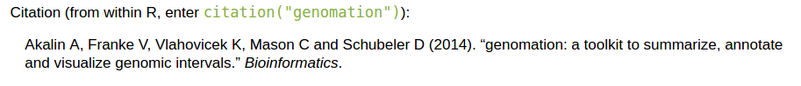
*Created by Altuna Akalin and Vedran Franke
Notes:
This package was created by Altuna and Vedran Franke right now his postdoc in 2011, in BioC since 1.5 years and published in 2014.
Bioconductor provides tools for the analysis and comprehension of high-throughput genomic data. Bioconductor uses the R statistical programming language, and is open source and open development
Before I started my PhD in Altuna’s lab I did half year internship in his lab
And during this time my task was to maintain this package and add some new functionalities.

Slide 3
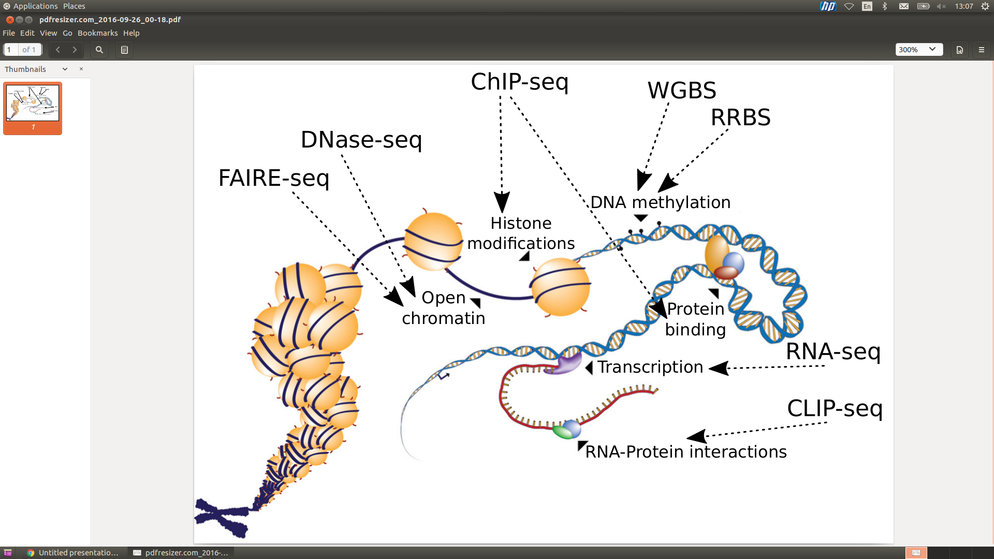
Applications
(adapted from AG Diehl, Trends Genet. 2016)
Notes:
Why genomation could be usefull for you?
It might help you with analysing HT-data such as DNAse-seq or FAIRE-seq so techniques for mapping active gene regulatory elements across the genome,
ChIP-seq to analyse protein binding sites or histone modifications, if you would like to analyse DNA methylation using WGBS or RRBS
As well as data from RNA-seq or CLIP-seq.
RRBS Reduced representation bisulfite sequencing
FAIRE-Seq (Formaldehyde-Assisted Isolation of Regulatory Elements)
Genomic interval summaries are widely used
Summaries of genomic intervals are one of the useful ways to communicate high-dimensional data
Regions of interest are picked and distribution of genomic intervals are summarized on those regions

Slide 4
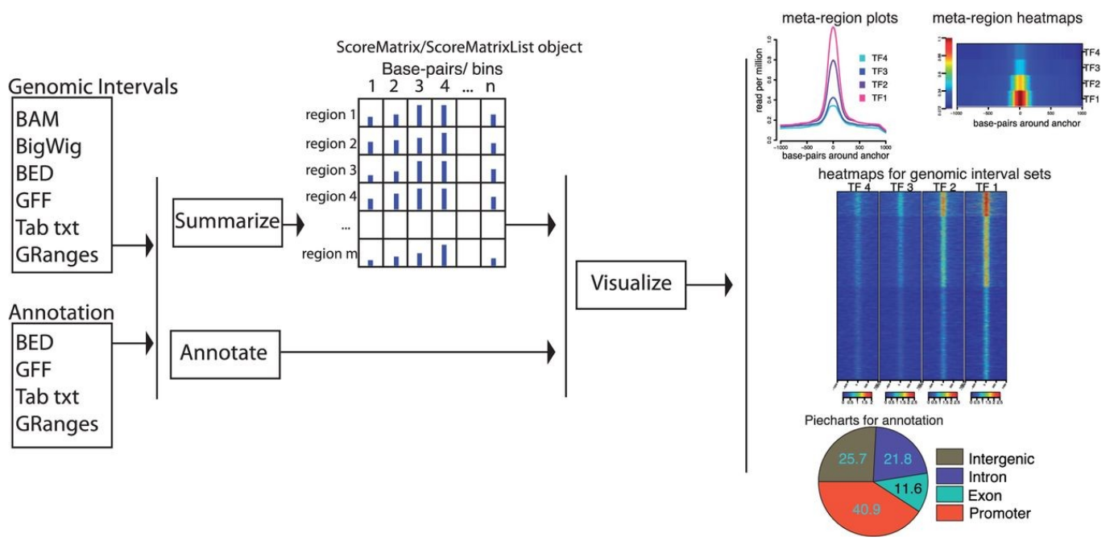
Overview of genomation features
(Altuna Akalin et al. Bioinformatics 2015)
Notes:
Genomation has a lot features super usefull for every day work in R and with genomic data. I can see on myself. The last year I’ve been quite intensively working
with analysing ChIP-seq data and honestly it has handy and helpfull tools not only to visualize stuff but also just to read various file format.
So genomation has functions that allow you to read your data:
from BAM files (so files that contain information about aligned reads into genome)
From Bigwig files (that have info about coverage of your reads)
Bed gff and txt files with coordinates of your peaks
Or granges objects that also contain info about coordinates of e.g. peaks but this object is derived from GenomicRanges package that I won’t talk about today.
So essentially when you have your experiment in these formats and you can
Annotate your genomic intervals: e.g. see what % of your intervals overlap with exon/intron/promoters
Summary of genomic scores or read coverages over pre-deﬁned regions e.g. extract the conservation proﬁle over e.g. ChIP-seq binding sites or CpG islands (equi and nonequi-width regions)
Visualize genomic interval summaries as meta-region plots or heatmaps.
Work with multiple ﬁle formats e.g. BAM, BED, bigWig, GFF and generic tabular text ﬁles containing chromosome location information.
do all these in R :)
So actually to sum up you can use these genomation functions to any HT that were you’d like to see its enrichment over some specificied by you genomic regions.

Slide 5
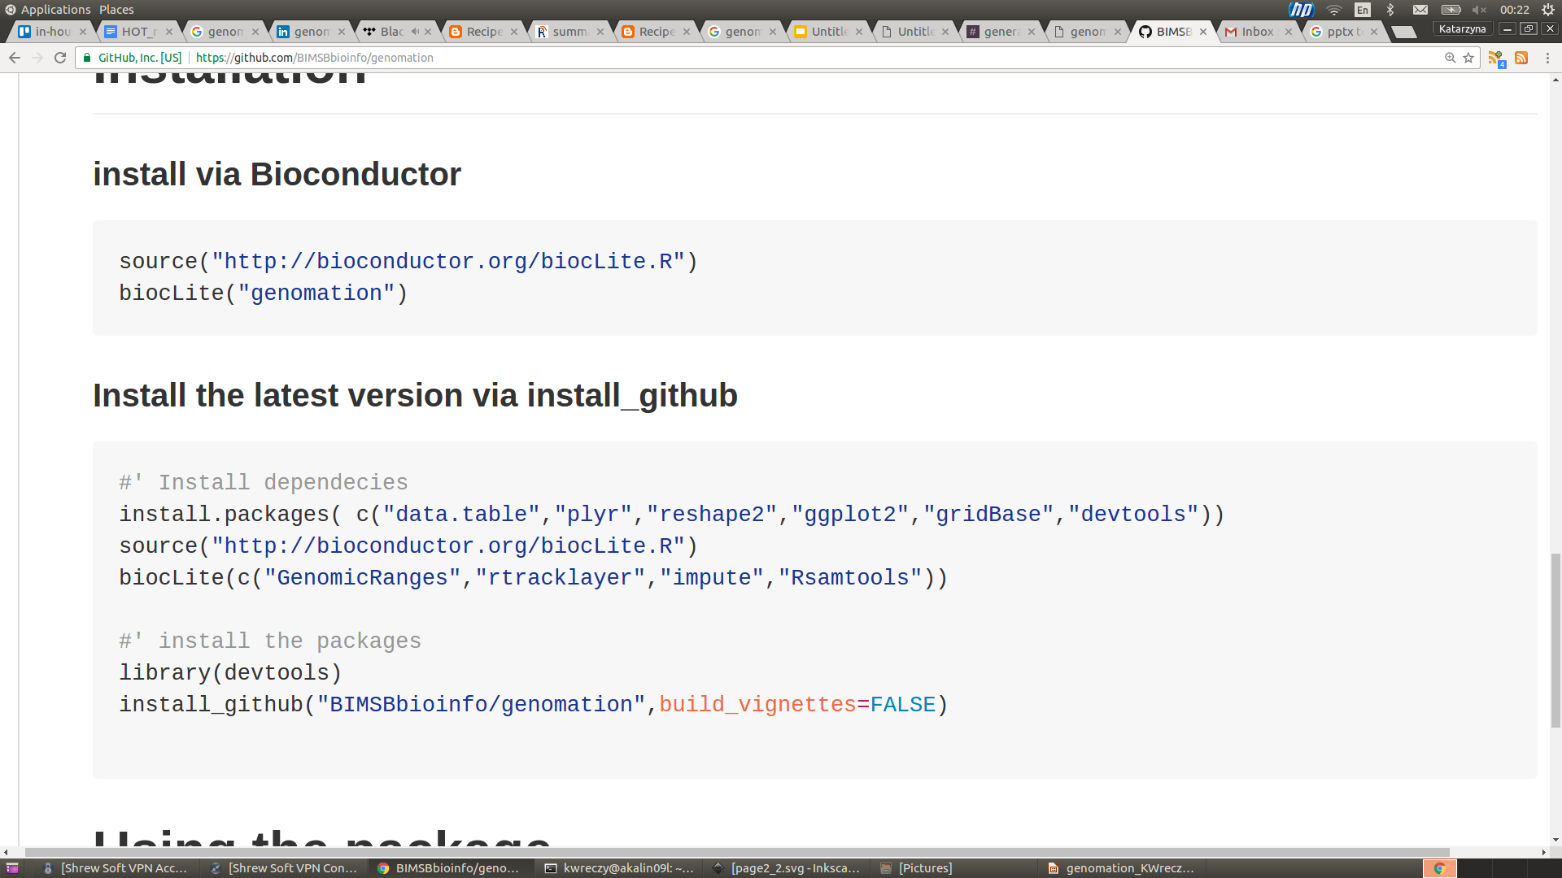
Installation
Via Bioconductor:
From GitHub:
Notes:
So first, how to install it. You can do it via bioconductor
Or directly from our github repository. Github repository has always the latest version of it, because first we push our changes there and then to bioconductor.
I dont know how much experience you have with maintaning R package in bioconductor but recently bioconductor stopped supporting
Git-SVN bridge (since bioconductor is stored in svn) and now they encourage to their so called git mirrors, if someone of you have some experience with it I would
Love to talk about it how to push changes to bioconductor in the most lets say elegant way.

Slide 6
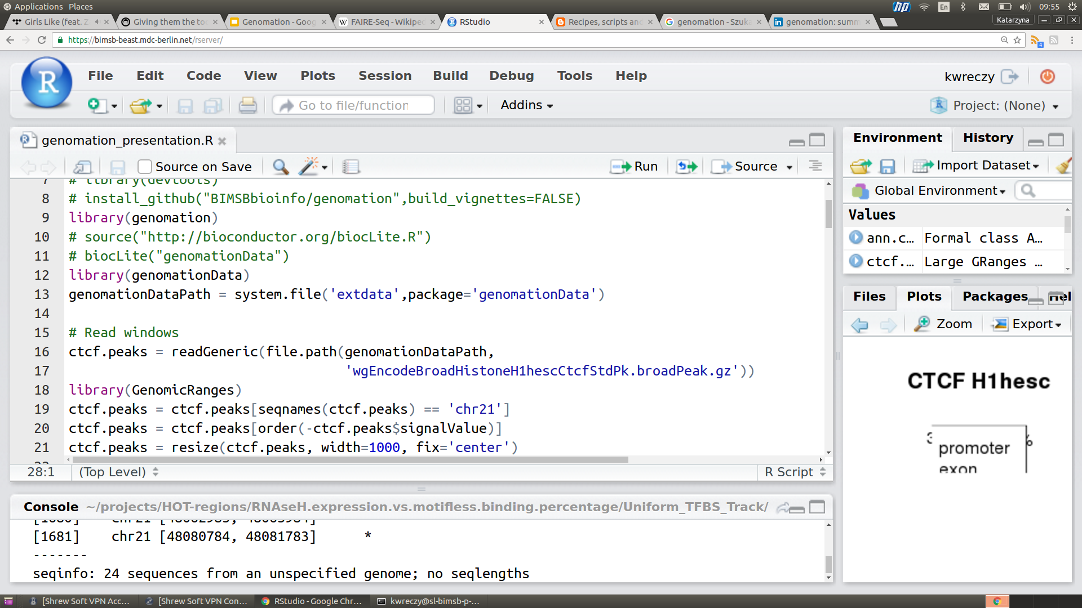
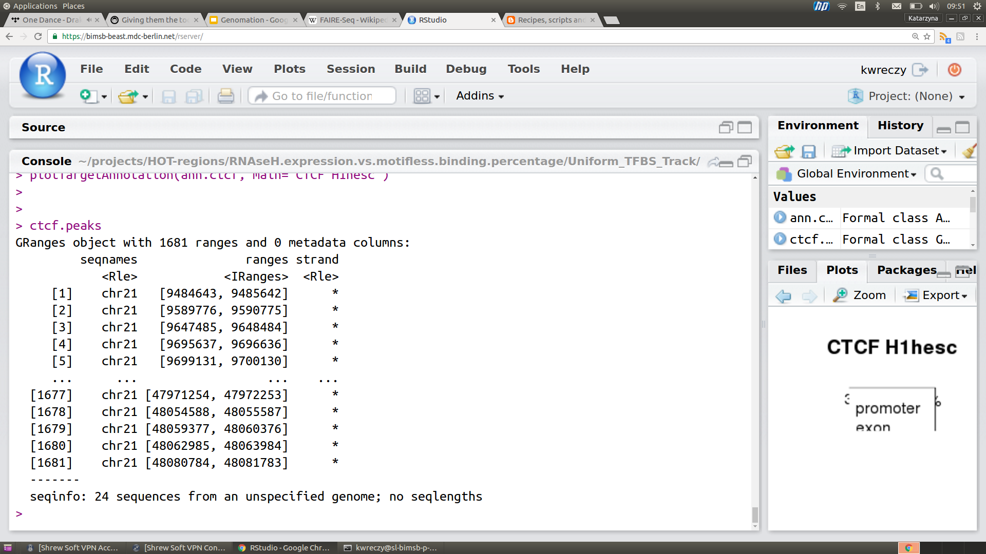
Data import
Needed for examples
Genomic intervals can be read from various file formats.
To read files:
readGeneric
readBed
readNarrowPeak
readBroadPeak
Notes:
genomationData is here on this slides for me needed for exampesBioC R package
Various ﬁle formats can be used in genomation. You can read in annotation or your genomic intervals of interest
readBed
Hesc = Human Embryonic Stem Cell Lines

Slide 7
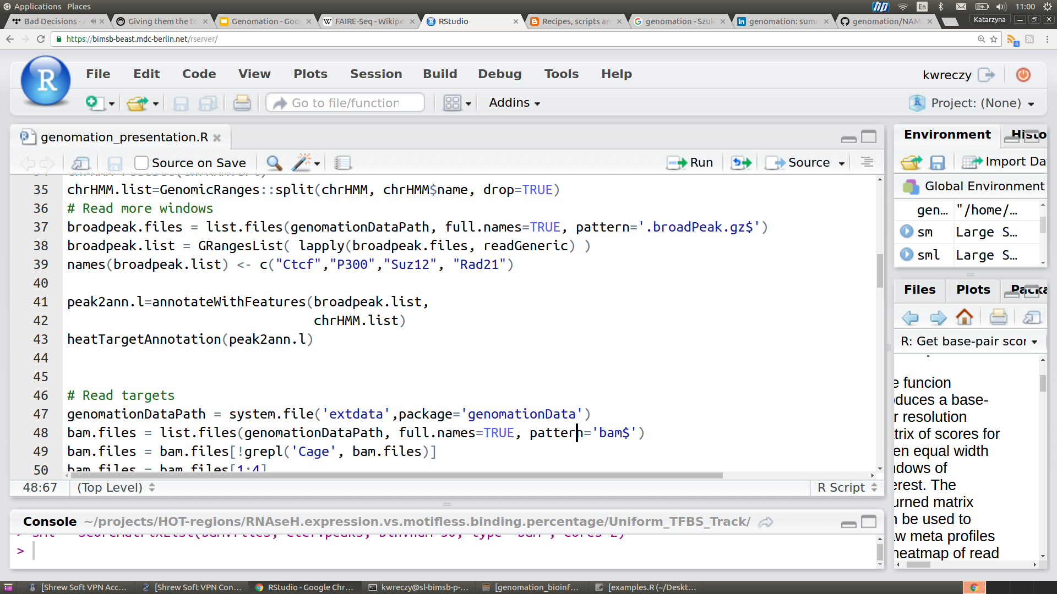
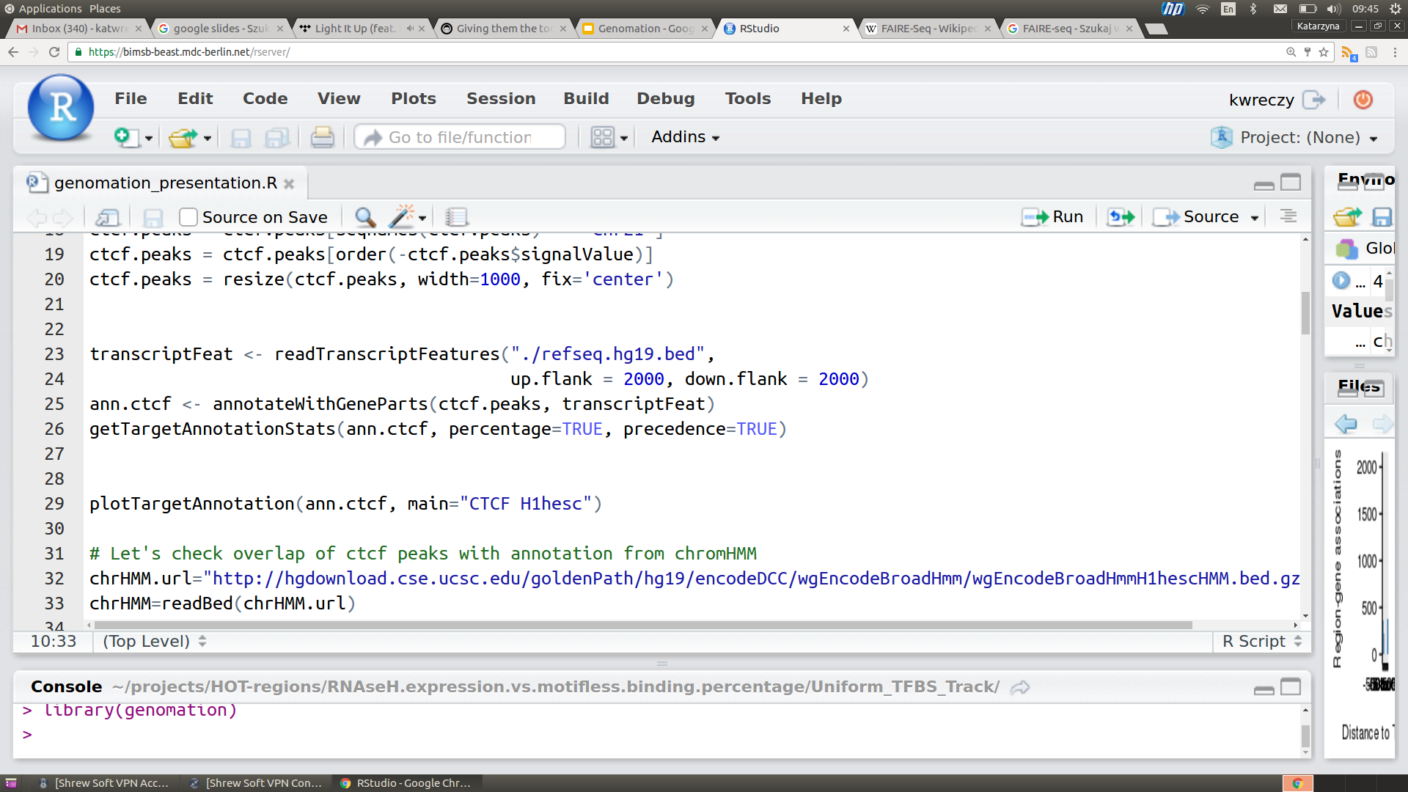
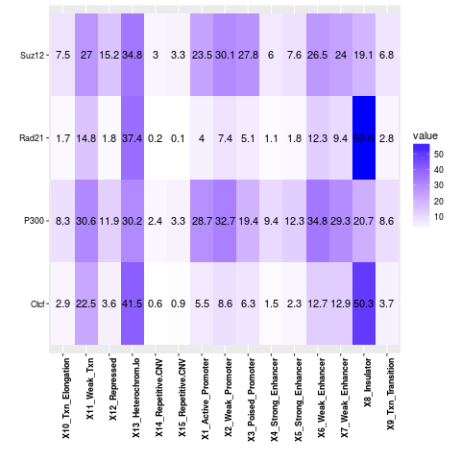
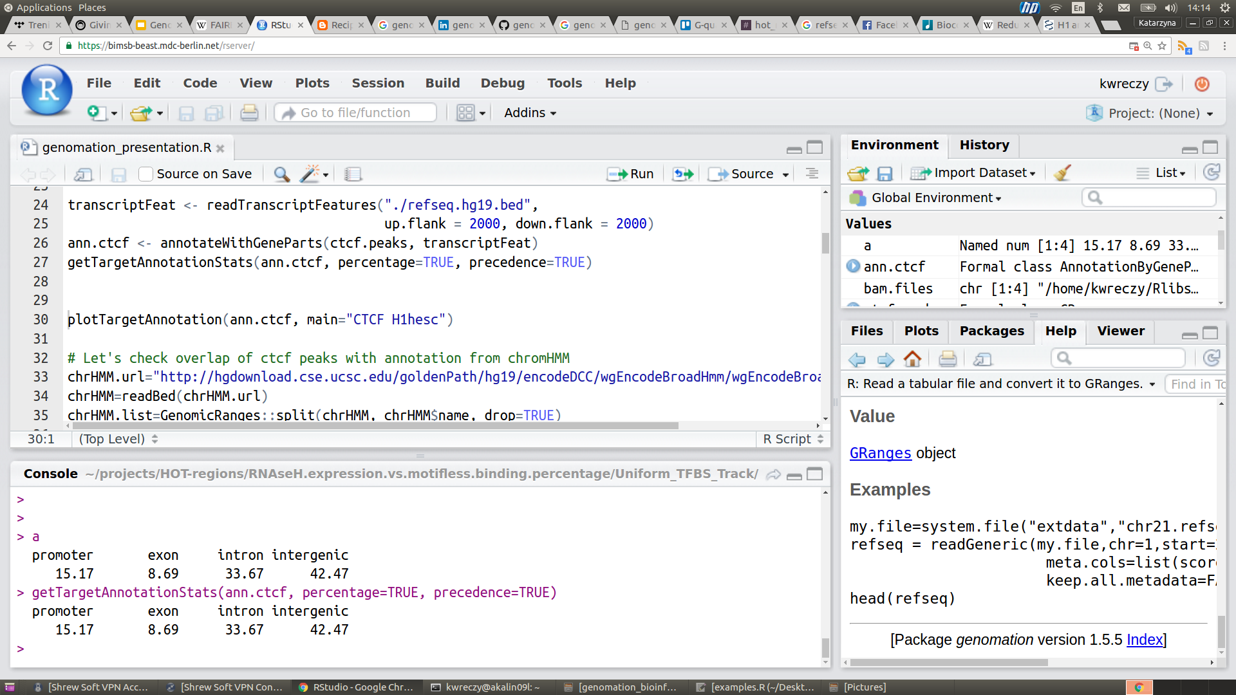
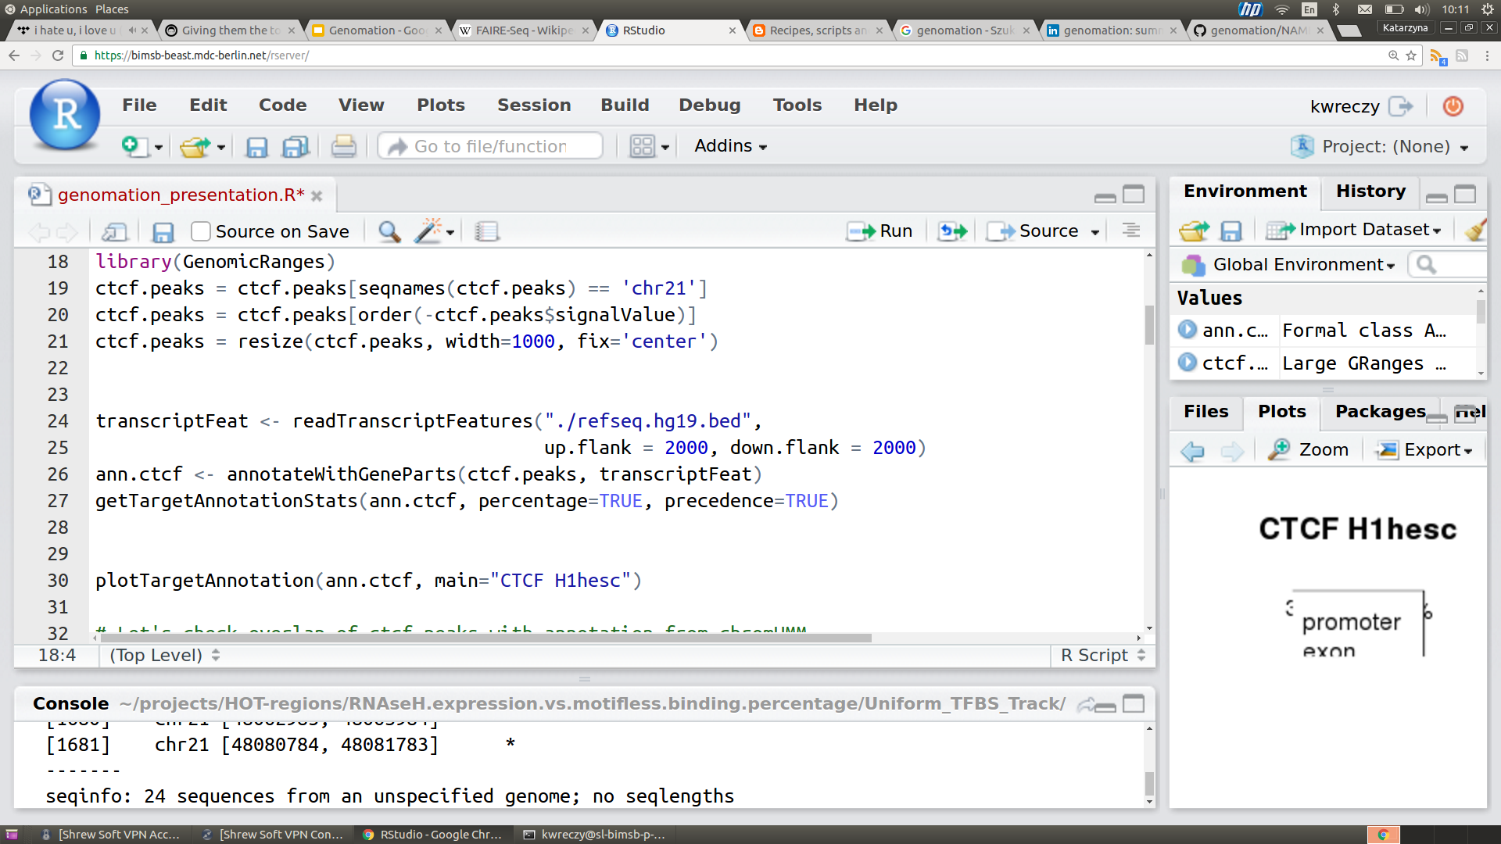
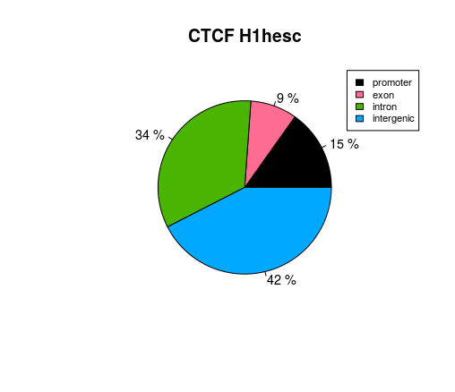
Annotate Genomic intervals
..or with any feature
Annotate with gene structures..
Notes:
The Reference Sequence (RefSeq) database
chromHMM annotations from ENCODE = ChromHMM is based on a multivariate Hidden Markov Model that explicitly models the presence or absence of each chromatin mark. The resulting model can then be used to systematically annotate a genome in one or more cell types
# Read transcripts from the refseq bed file
# within 4 kb distance from the longest transcript of each gene
-> Function for reading exon intron and promoter structure from a given bed file
Up.flank ---> up-stream from TSS to detect promoter boundaries
Precedence ---->
TRUE|FALSE. If TRUE there will be a hierachy of annotation features when calculating numbers (with promoter>exon>intron precedence)That means if a feature overlaps with a promoter it will be counted as promoter overlapping only, or if it is overlapping with a an exon but not a promoter, #' it will be counted as exon overlapping only whether or not it overlaps with an intron.

Slide 8
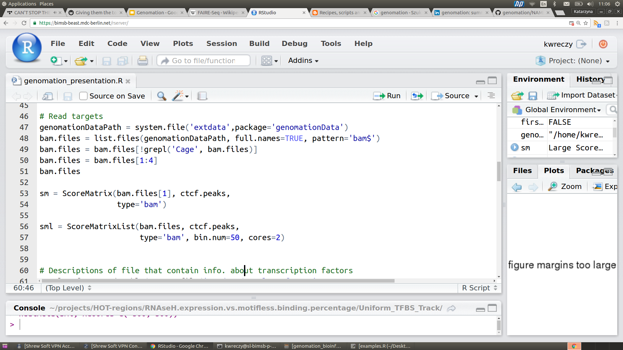
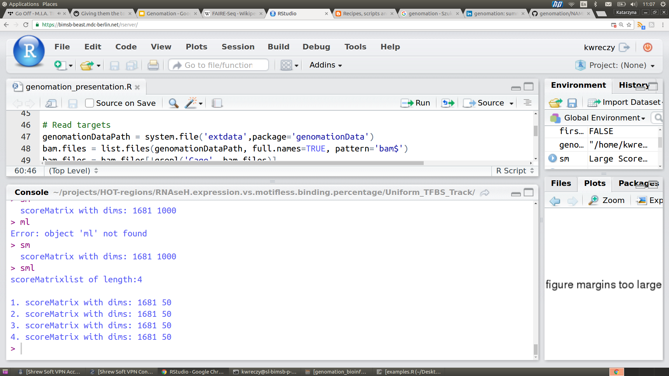
Summarize genomic intervals over target
Target:
GRanges
BAM
BigWig
To summarize:
ScoreMatrix
ScoreMatrixBin
ScoreMatrixList
Notes:
ScoreMatrix
ScoreMatrixBin
BAM- > single and paired-end BAM

Slide 9
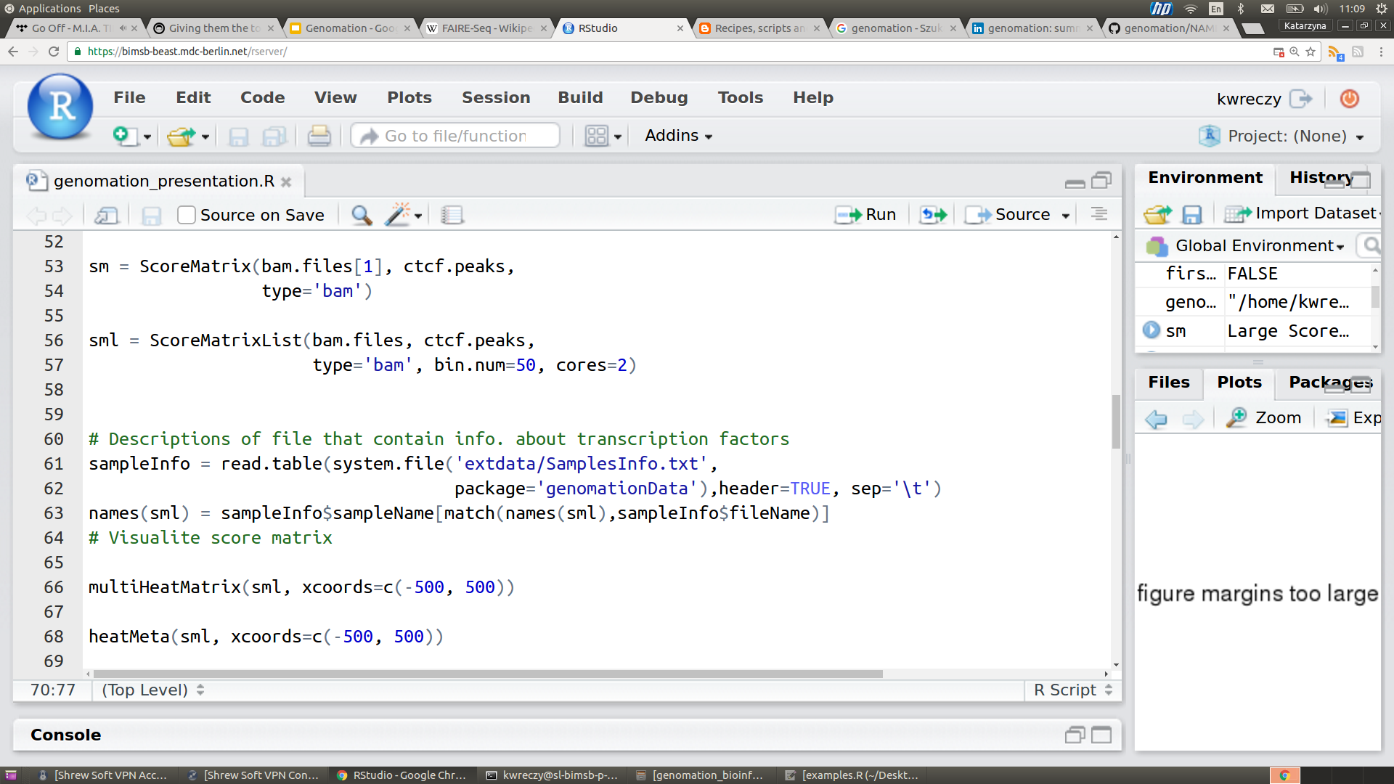
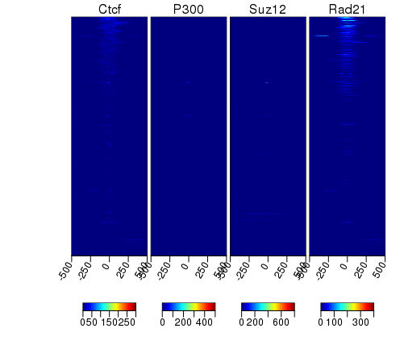
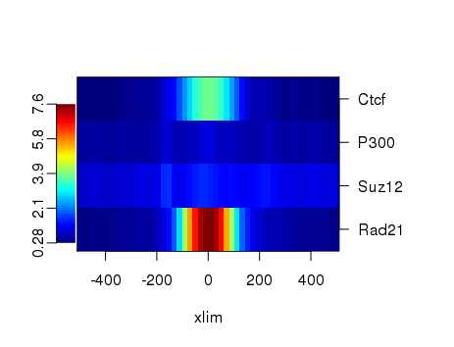
Visualize summary matrices as heatmaps and meta-regions plots
Notes:
Visualizating ScoreMatrix

Slide 10
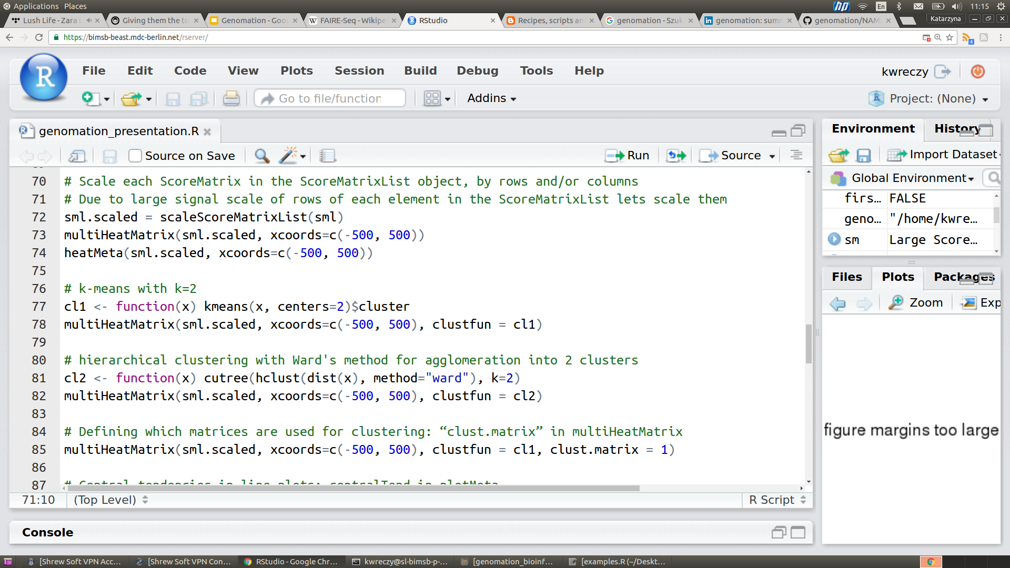
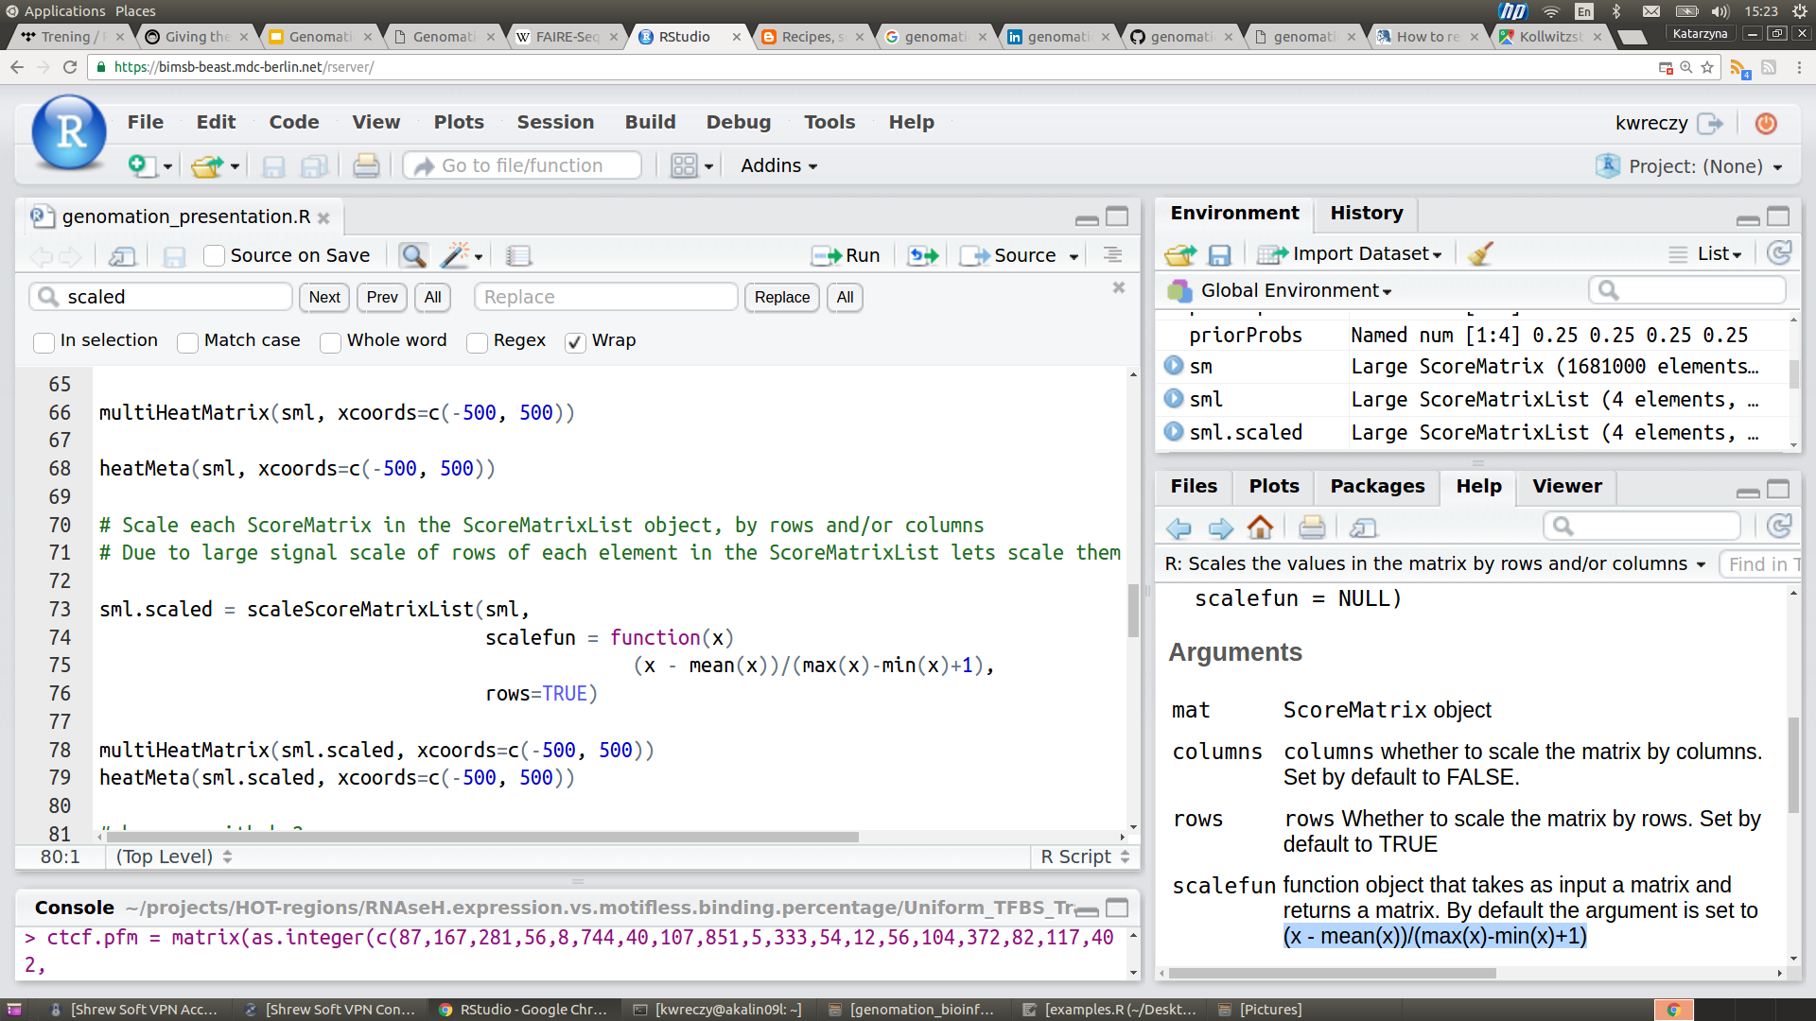
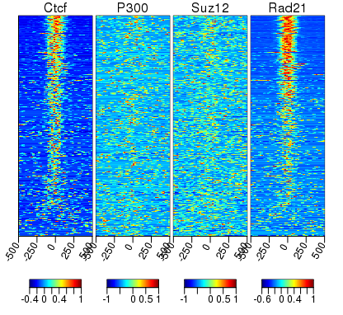
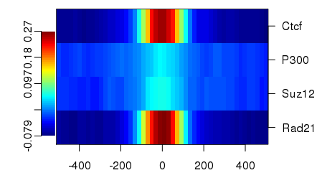
Scale heatmaps
Scale each ScoreMatrix in the ScoreMatrixList object by rows and/or columns

Slide 11
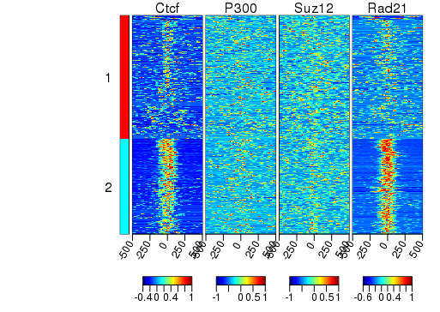
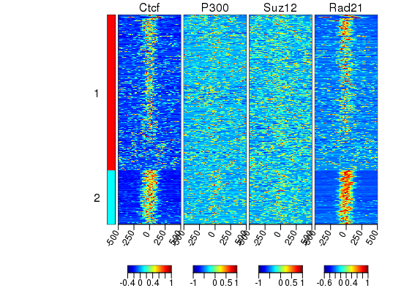
Cluster heatmaps
Hierarchical clustering with Ward's method for agglomeration into 2 cluster
K-means with k=2
Notes:
Besides clustering people can group windows by themselves:
Group -> a list of vectors of row numbers or a factor. The rows will be reordered to match their grouping.

Slide 12
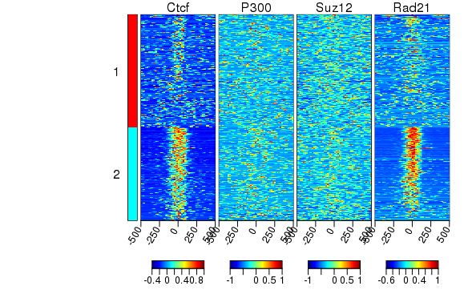
Cluster heatmaps
Define which matrices are used for clustering

Slide 13
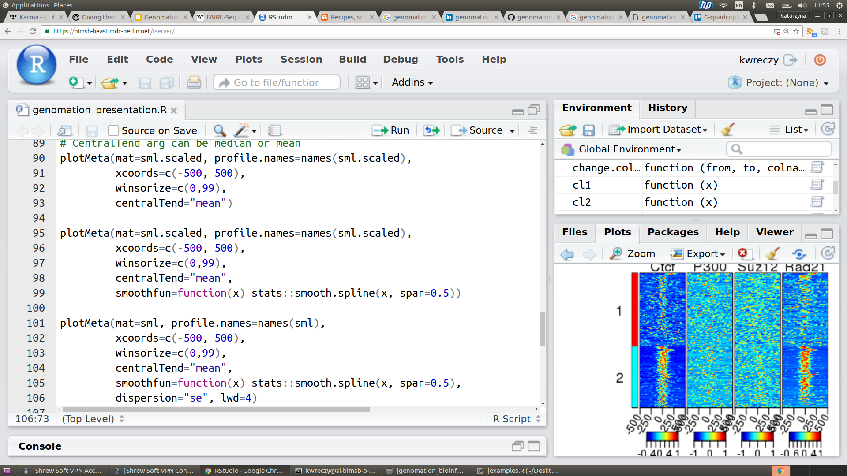
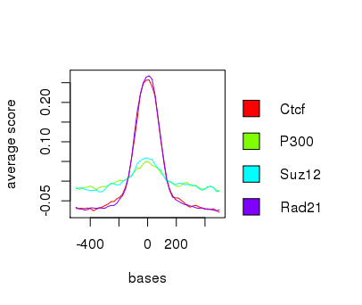
meta-plots
centralTend:
mean
median

Slide 14
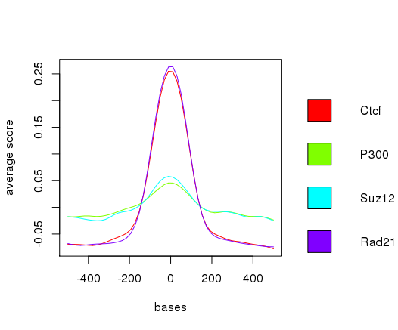
Smooth meta-plots

Slide 15
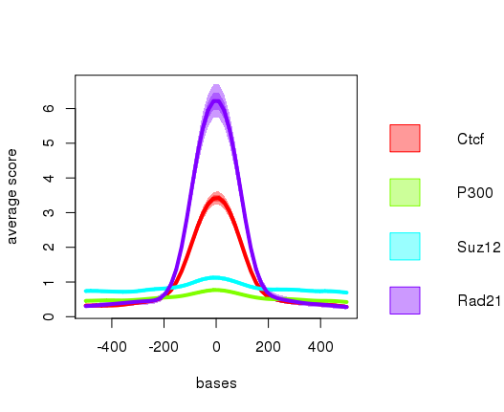
Add dispersion to meta-plots
Dispersion:
"se" shows standard error of the mean and 95 percent confidence interval for the mean
"sd" shows standard deviation and 2*(standard deviation)
"IQR" shows 1st and 3rd quartile and confidence interval around the median based on the median +/- 1.57 * IQR/sqrt(n) (notches)

Slide 16
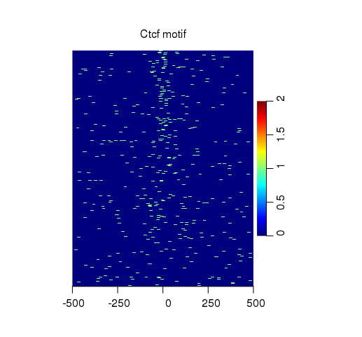
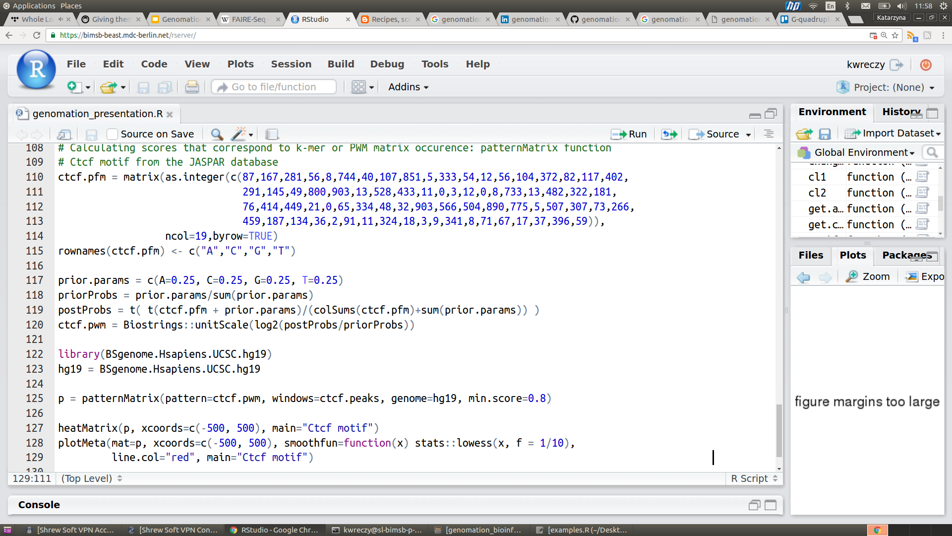
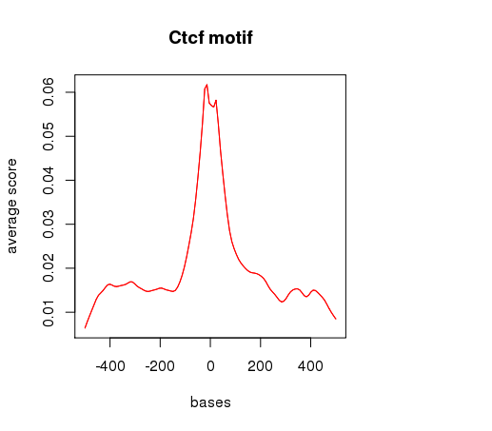
motif enrichment over genomic intervals
Get scores of k-mers or PWM matrix over windows
Usefull for ChIP-seq
Notes:
Get scores that correspond to k-mer or PWM matrix occurrence for bases in each window
Usefull for analysing ChIP-seq

Slide 17
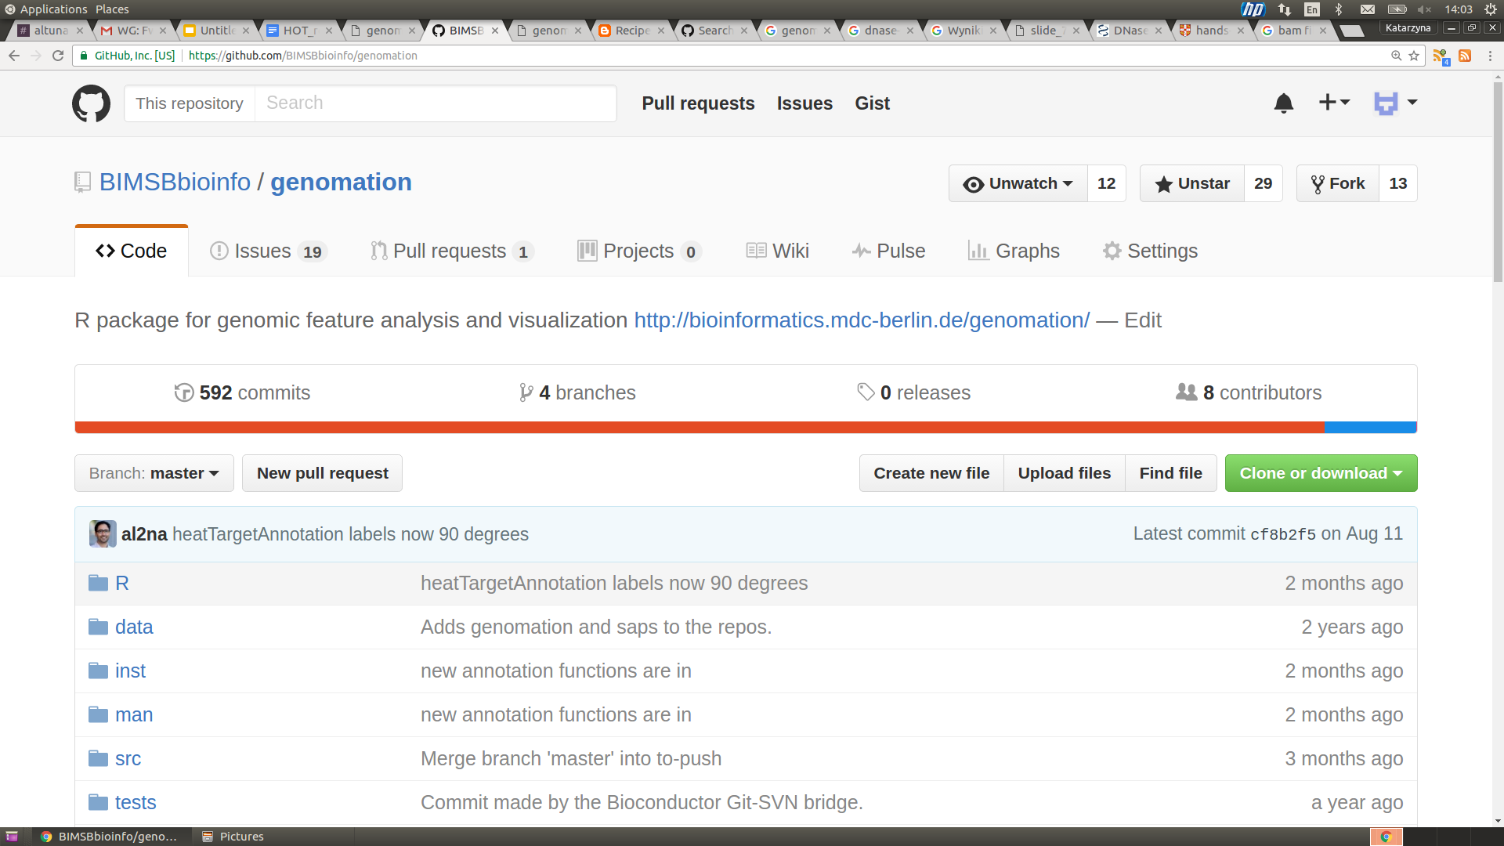
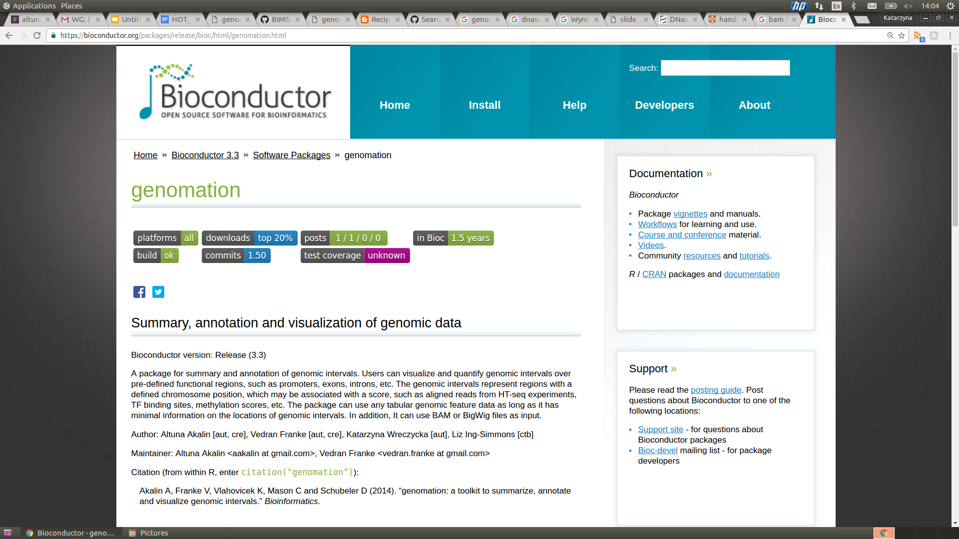
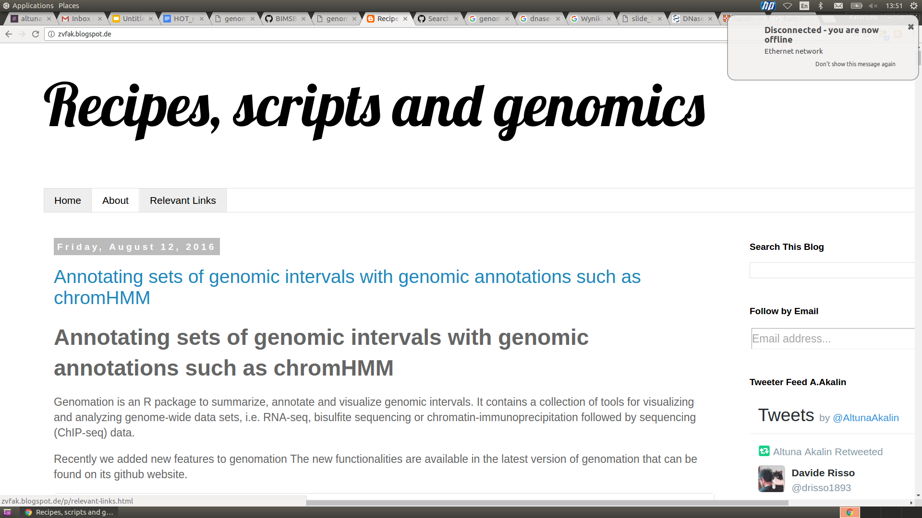
For more info
github.com/BIMSBbioinfo/genomation
bioconductor.org
zvfak.blogspot.de (Altuna’s blog)
groups.google.com/forum/#!forum/genomation
Notes:
For more information about genomation,
Description of its function and more usage examples
You can find them first of all on bioconductor genomation website, github website
If you have any question or you found a bug or have idea how we could improve this package feel free to write on our google groups forum on on github
Or to me directly

Slide 18
Thank you for your attention!
katarzyna.wreczycka@mdc-berlin.de
Notes:
Thanks for your attention. Feel free to ask me question now
Or later just drop me an email if you have any questions related to genomation, R or programming.

